Slide 1

CSGO Player Performance Dashboard
CSGO Player Performance Dashboard
Name of the Student : Ahmad Mohamed Aslam
Name of the Supervisor : DR. Jawed Ahmed
Enrollment Number : 2021-310-025
Course:BTECH CSE
SUBMITTED TO: Department of Computer Science & Engineering School of Engineering Sciences & Technology
JAMIA HAMDARD
​

Slide 2

Creating a dashboard for CSGO player performance
Explore CS:GO player performance through data-driven insights.
Python empowers us to create an interactive dashboard for analysis.
Uncover player strengths and areas for improvement.
Utilize Pandas, Matplotlib, and Plotly for data aggregation and visualization.
Track kill-death ratios, accuracy, map-specific performance, and weapon preferences.
Empower esports enthusiasts, players, and coaches with valuable insights.
Elevate gameplay strategies and refine performance through informed decisions.
Unlock the secrets hidden within the data of CS:GO to enhance gameplay.

Slide 3




Python Libraries
Dash for Web
Plotly for Graphs
Numpy for Maths
Interactive web apps
Data visualization
Pandas for Data
Calculations
Data manipulation

Slide 4

Data Source
Utilized web scraping techniques to gather player performance data from online CS:GO databases.
Employed Python libraries like BeautifulSoup and Requests to extract player statistics from multiple sources.
Designed a script to iterate through player profiles, retrieving information such as kill-death ratios, accuracy, and match history.
Structured the collected data into a structured format, ensuring consistency and relevance across all entries.
Implemented data parsing and cleaning methods to handle inconsistencies and missing values.
Stored the cleaned dataset in a suitable format, such as CSV or JSON, for easy access and manipulation within the Python program.
Integrated the dataset into the dashboard program using Pandas for data manipulation and visualization libraries like Matplotlib and Plotly for generating interactive visualizations.
Using CS:GO stats dataset for analysis

Slide 5
Visualizing Data
Utilize Pandas to import the dataset of 800 players into the Python program.
Utilize Matplotlib and Plotly to create various visualizations such as bar charts, scatter plots, and heatmaps.
Implement interactive features like dropdown menus and sliders to allow users to customize the displayed data.
Group players based on different criteria such as rank, playing style, or preferred weapons for comparative analysis.
Plot performance metrics over time to identify trends and patterns.
Incorporate tooltips to provide additional information upon hovering over data points.
Ensure the dashboard is user-friendly and visually appealing for easy interpretation of player performance insights.
Utilizing plotly.graph_objs for interactive visuals

Slide 6

Code Explanation
The code sets up a web-based dashboard using Dash for comparing CS:GO player performance.
It imports necessary libraries including Dash, Plotly, NumPy, and Pandas for data manipulation and visualization.
Player data is loaded from a CSV file and structured into a Pandas DataFrame.
The dashboard layout includes HTML components for title, dropdowns, and buttons to select players and stats for comparison.
A callback function triggers when the submit button is clicked, generating a bar plot comparing selected stats for chosen players.
The application runs locally using app.run_server().
Overall, it provides an interactive platform for analyzing and comparing CS:GO player performance dynamically.
Understanding the Python code for dashboard creation

Slide 7
Interactive Elements
1
2
Dash Library
Engage Users
Incorporate interactive elements with the powerful Dash library for dynamic user experience.
Enhance user engagement by enabling interactive features that make the dashboard come alive.

Slide 8


User Input
Interactive Features
Engage Users
Utilize Input, Output, and State for dynamic user experience
Enhance engagement through personalized interactions

Slide 9

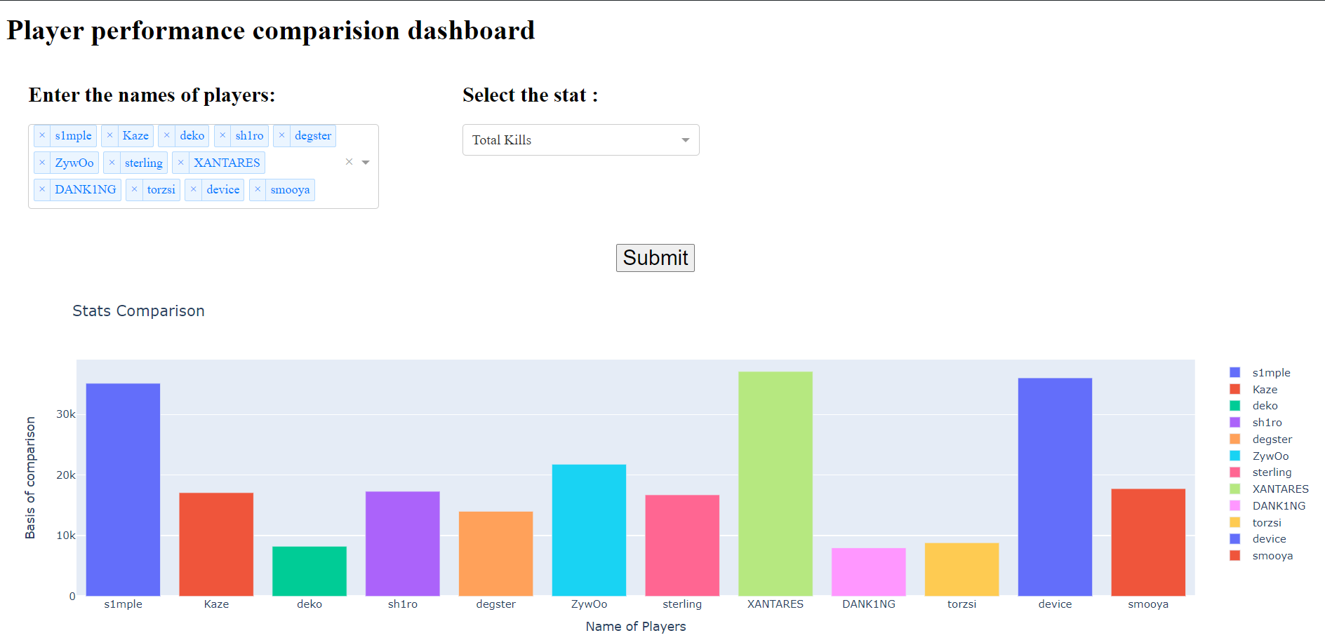
Dashboard Demo
Showcasing the live dashboard functionality

Slide 10
CONCLUSION
Data Loading: Loads player stats from a CSV file.
Layout: Constructs a user interface with dropdowns for selecting player names and stats, and a submit button.
Callback Function: Defines a callback that triggers when the submit button is clicked, generating a bar graph comparing selected player stats.
Visualization: Displays the comparison graph.
Interactivity: Users can select multiple players and stats for comparison

Slide 11



